Slide 1
ICA and modern cartography
László Zentai
ICA Secretary-General
Department of Cartography and Geoinformatics
Eötvös University, Budapest, Hungary
http://icaci.org – sg@icaci.org

Slide 2
What is ICA?
International Cartographic Association
The world authoritative body for cartography, - the conception, production, dissemination and study of maps.
ICA Mission
To promote the discipline and profession of cartography internationally.

Slide 3
Aims of ICA
Understand and solve world-wide problems using cartography;
Informing about environmental, economic, social and spatial information through mapping;
Global forum on cartography;
Transfer of new cartographic technology and knowledge;
Multi-national cartographic research;
Enhance cartographic education;
Promote professional and technical standards.

Slide 4
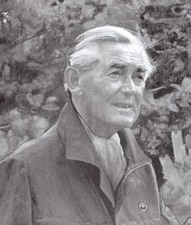
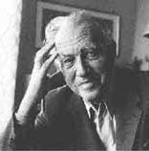
The foundation of the ICA
Idea for an international cartographic organisation: Carl Mannerfelt, Sweden (1956).
The association was founded June 9, 1959, in Bern, Switzerland.
1961 - First General Assembly, Paris
First President Eduard Imhof, Switzerland
First international cartographic conferences
1962: Frankfurt (Germany)
1964: Edinburgh (UK)
1967: Amsterdam (The Netherlands)
1968: Delhi (India)
1970: Stresa (Italy)

Slide 5
ICA activities
General Assembly
Conferences (map exhibitions)
Commissions and Working Groups
Publications (Springer)
Links with sister societies
Outreach
ICA Strategic Plan
ICA Research Agenda
Awards

Slide 6
ICA commissions
The realisation of the main objectives of the Association, the encouragement and coordination of cartographic research is assigned to the commissions and working groups.
Commissions and working groups form the most vital part of the Association.
Commissions were established for the first time at the General Assembly in 1964:
Training of Cartographers
Definition, Classification and Standardization of Cartographic Terms
Automation in Cartography.

Slide 7
ICA commissions (1984)
Standing commissions:
Training and Education
Map Production Technology
Advanced Technology
History of Cartography
Ad-hoc commissions:
Thematic Mapping from Satellite Imagery
Urban Cartography
Tactual Mapping
Marine Cartography
Population Cartography
Working groups:
Cartographic Enterprise
Concepts and Methodology in Cartography
Map Use

Slide 8
ICA commissions (1995)
ICA had 13 commissions and 2 working groups.
Most of the commissions were very similar to the previous ones, but there were some new themes:
Standards for the Transfer of Spatial Data
Spatial Data Quality
Visualization

Slide 9
ICA commissions (2011)
28 commissions, some of them are totally specialized, like
Map Production and Geo-Business
Maps and Society
Neocartography
Ubiquitous Mapping
Use and User Issues
New topics:
Early Warning and Crisis Management
Cognitive Visualization
Data Quality
Geoinformation Infrastructures and Standards
Geospatial Analysis and Modeling
GI for Sustainability
Open Source Geospatial Technologies

Slide 10
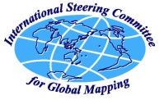
Sister societies of ICA
Joint Board of Geospatial Information Societies
Global Spatial Data Infrastructure Association
IEEE Geoscience and Remote Sensing Society
International Association of Geodesy
International Federation of Surveyors
International Geographical Union
International Hydrographic Organisation
International Map Trade Association
International Society for Photogrammetry and Remote Sensing
International Steering Committee for Global Mapping Secretariat: Geographical Survey Institute

Slide 11
Selected objectives of the ICA
To contribute to the understanding and solution of world problems through the use of Cartography and GIScience in decision-making processes.
To facilitate the transfer of new Cartographic and GI knowledge between and within nations, especially to developing nations, and to undertake Capacity Building, notably for communities in need.
To perform or to promote multi-national Cartographic and GI research, including collaborative and trans-disciplinary research, in order to solve scientific and applied problems.
To offer its expertise and knowledge of technical developments to other organisations, e.g. governments, statistical bodies, GI management organisations.
To support map-related research in specific topics such as child education, history, theory, and assistance for the visually-impaired.

Slide 12
Modern cartography
The actual developments in technology have helped to „democratise” the cartographic communication processes (user-friendly graphics packages for presentation, GI Systems for geographic data exploration and analysis, visualisation and representation).
This has led to a renewed interest in the discipline of cartography, and the profession, therefore, continues to flourish with products still ranging from paper maps to maps and atlases on the Internet, like 3D maps, animated maps, and location based services.
The „renaissance” of cartography in recent years has resulted in a dynamic combination of the mapping impulse, the technology used in handling and disseminating geospatial data, the increasingly diverse and expanding role of Cartography in everyday life, and the wide-ranging and innovative application areas and uses for maps.

Slide 13
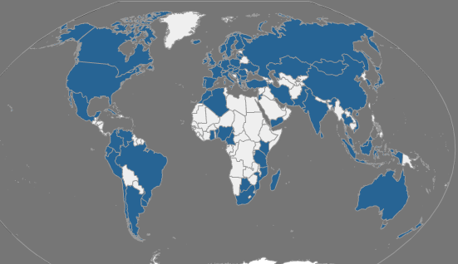
ICA national members
Notes:
Users: depends on target of the work
Policy level: to support
In depth analyzes: who are able to change paramteres

Slide 14
ICA Strategic Plan
Number of actions related to:
Ideas and Actions for the Organisation
Wider Operational Environments

Slide 15
Activities
General Assembly
Conferences
Commissions and Working Groups
Publications
Links with sister societies
Outreach
Fostering and supporting research

Slide 16
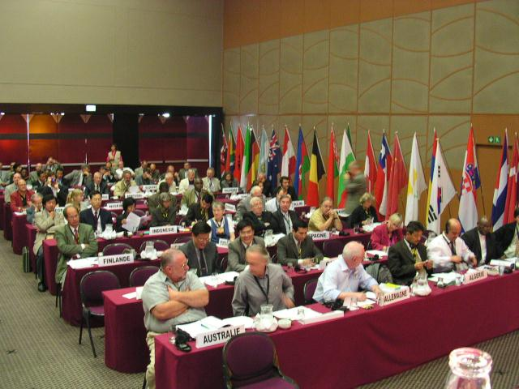
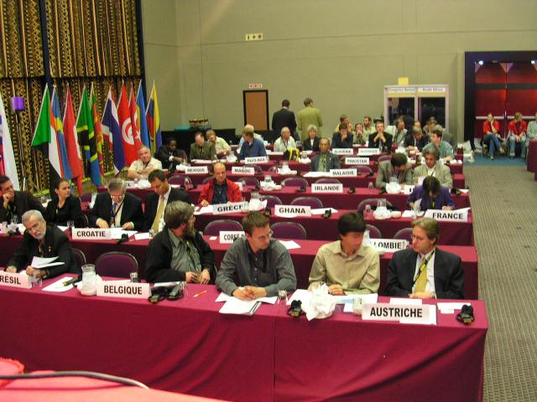
General Assembly

Slide 17
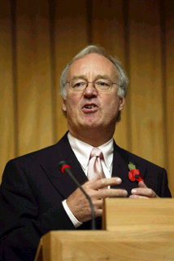
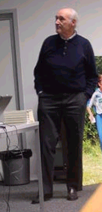
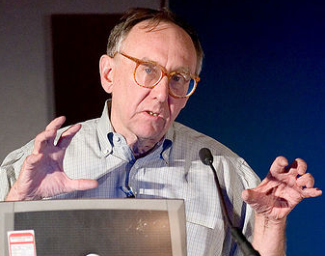
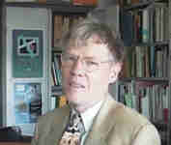
Awards
Carl Mannerfelt Gold Medal
Highest award of the ICA for Cartography and GI Science.
Professor David Rhind (UK) and Professor Ernst Speiss (Switzerland), 2005.
Jack Dangermond (USA), 2007
Ferjan Ormeling (NL), 2009
Honorary Fellowships
O'Reilly Media, Inc.

Slide 18
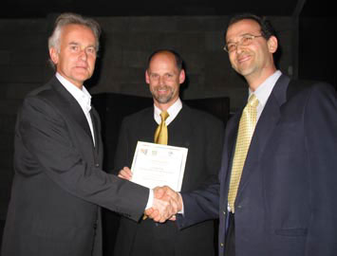
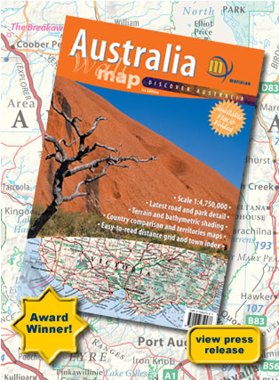
Map Exhibition Awards
ICA Mapping Excellence Awards – at each conference
Photo: Meridian Maps

Slide 19
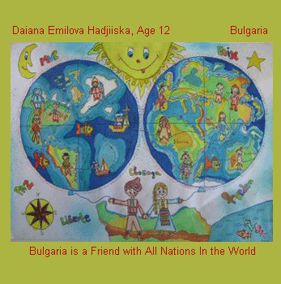
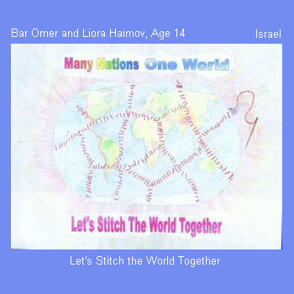
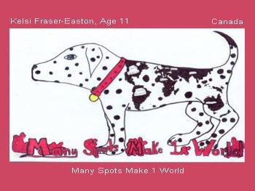
Barbara Petchenik Children's World Map Competition
Commission on Children and Cartography
http://children.library.carleton.ca/

Slide 20
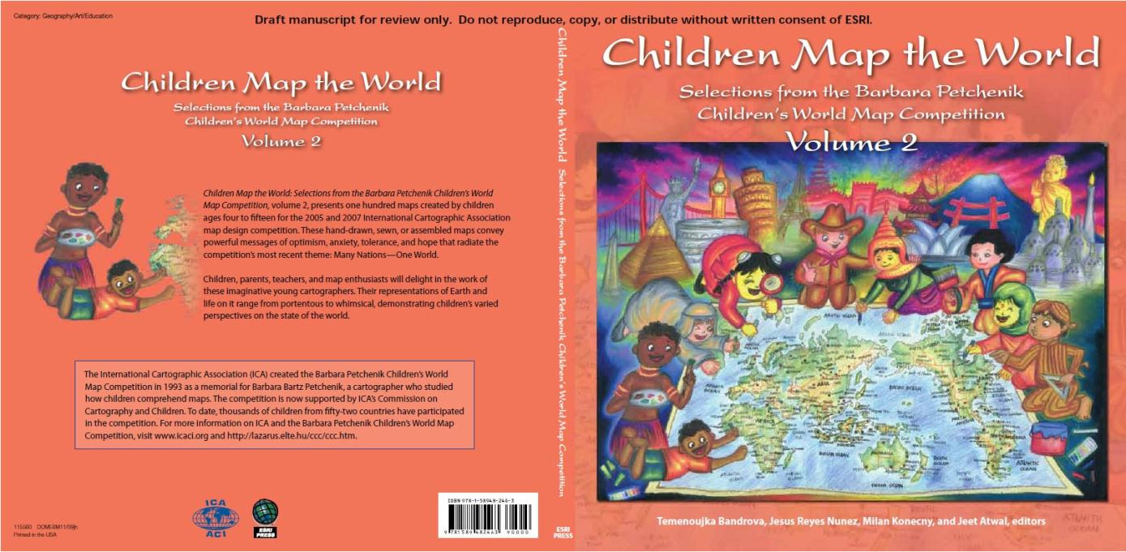

Slide 21
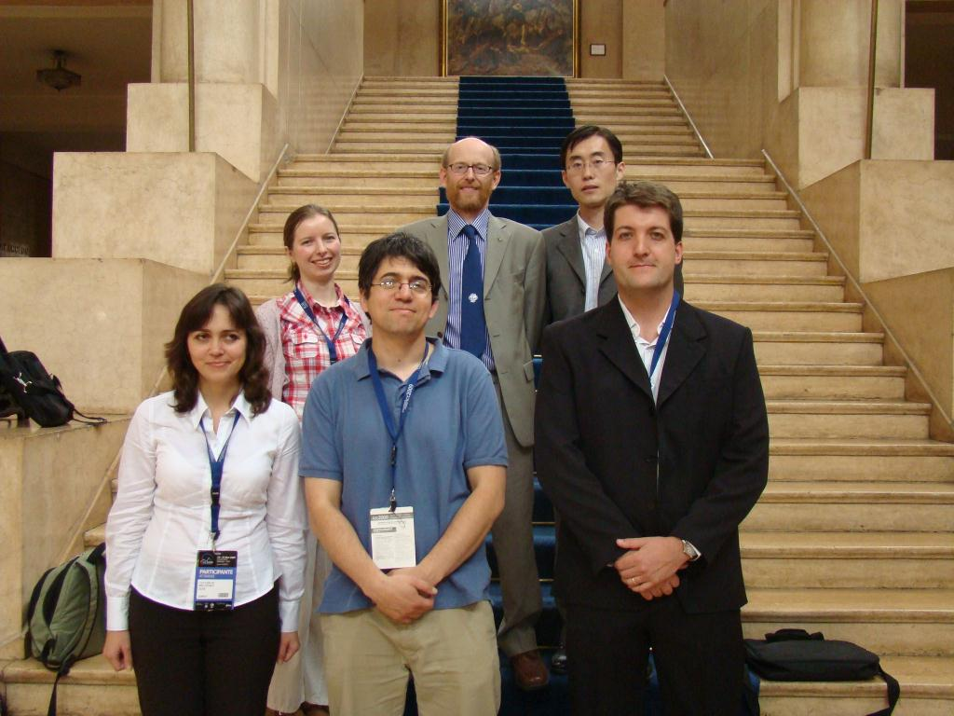
Young Scientists Travel Awards

Slide 22
Publications
Books
Affiliate journals
CaGIS
Cartographic Journal
Cartographica
ICA Newsletter
via Commissions and Working Groups

Slide 23
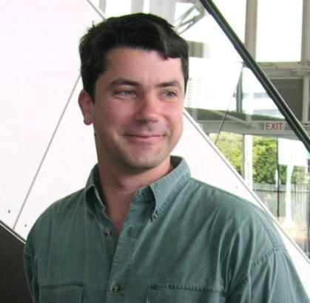
Publications
Newsletter
Editor, ICA Newsletter: Igor Drecki, New Zealand

Slide 24
Research Agenda on Cartography and GI Science
Geographic Information
Metadata and SDIs
Geospatial Analysis and Modelling
Usability
Geovisualization, Visual Analytics
Map production
Cartographic Theory
History of Cartography and GI Science
Education
Society

Slide 25
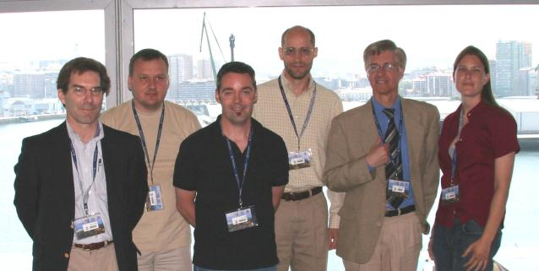
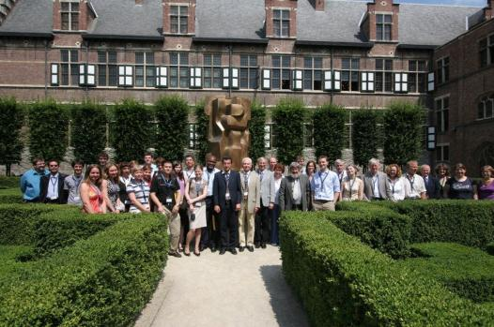
Commission and Working Group Activities
Notes:
David Danko - ESRI a member of the ICA Standards Commission

