Slide 1
SDI and Management Quality of Geographic Information
Joselyn Robledo Ceballos: Ingineer en Geomensura
Joselyn.robledo@saf.cl

Slide 2
Good morning everyone, my name is Joselyn Robledo, I work in the Aerofotogrametric Service in Chile, my profession is enginner in Geomensura. My work is about SDI and management quality of geographic information.
My mission today is tray to convince this commission of the importance of including topics of quality and management of geographic information in yours investigation lines, Likewise, to includ this tematic in the publication of the ICA.

Slide 3
We have seen these days, the importance of SDIs, the management of geographic information in natural disasters, the vision of future semantic developments, the importance of open geographical information, etc. All this associated with the sustainable development of the countries, but, if this information is not of quality and also opportunely make available, it will not be able to collaborate with the correct taking of decisions at governmental level.

Slide 4
The proposal is to implement a specific quality management system for geographic information, based on a group of regulations of the technical committee 211.
This system of management is implemented according to the life cycle of a cartographic product (Planning, production, operation and delivery).
In practice the following scheme is proposed:

Slide 5
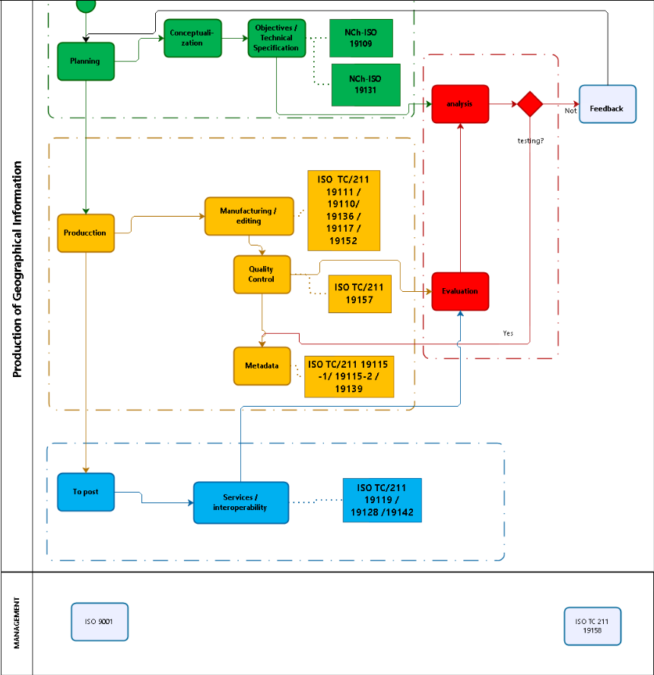

Slide 6
The first stage is associated with the product design, which determines its objectives, conceptual design and technical specifications, followed by the production process whose main tasks are to establish and execute the production processes and to control the quality of these in the different productive stages, According to the technical specifications, determining their level of conformity. Then there is the process of publishing this data through the use and exploitation of web services, each stage with the associated regulations in each process. Finally, to guarantee the operation of this methodology there must be a quality management system based on ISO 9001 and ISO 19158 standards. It should be mentioned that these standards are not the only ones that can be associated with the process and that they will also depend on the type of product.

