Slide 1
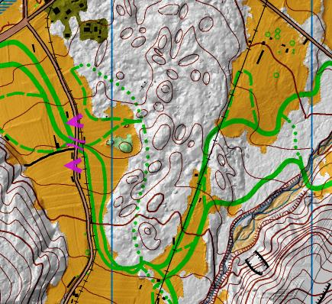
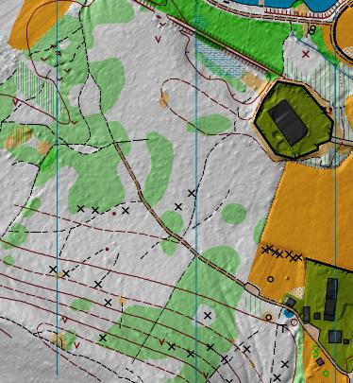
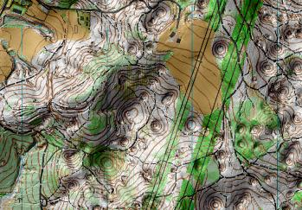
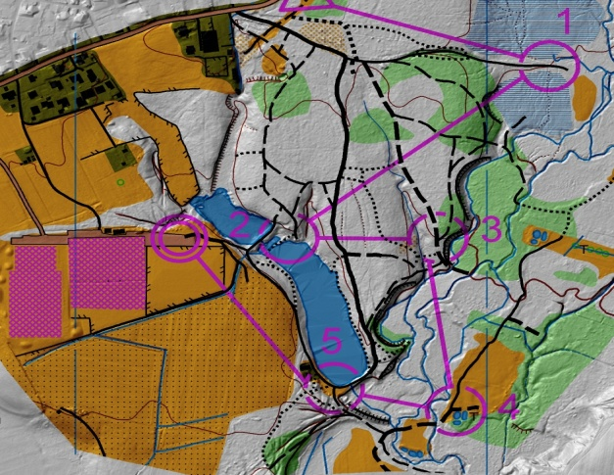
Some experiences in making Orienteering maps in Slovenia from airborne laser scanning data
Dušan Petrovič
Faculty of Civil and Geodetic Engineering
University of Ljubljana
Slovenia
email: dusan.petrovic@fgg.uni-lj.si

Slide 2
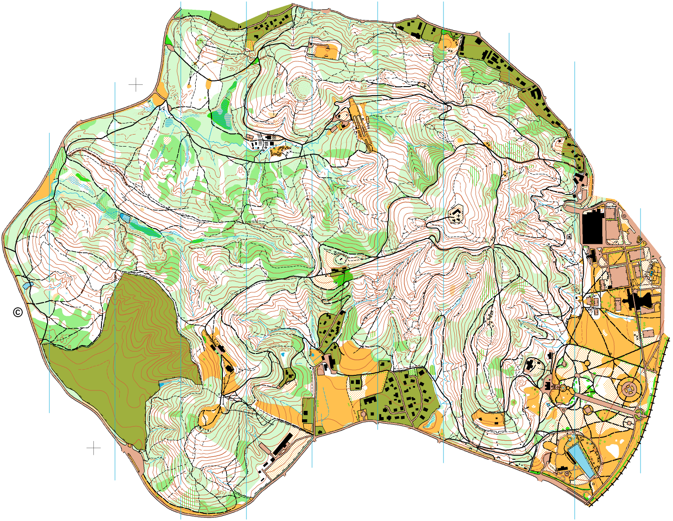
Motivation:
Orienteering maps are thematic maps with very detailed content (fully standardised)
production is due to extreme detainees of content very expensive, time consuming and it requires a lot of terrain work made by skilled mapmaker
necessity for many new maps

Slide 3
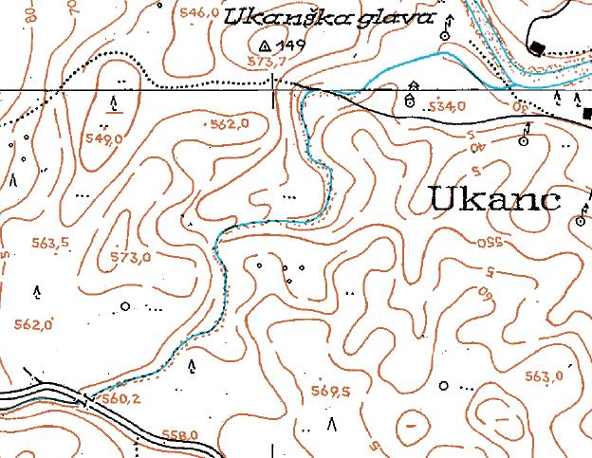
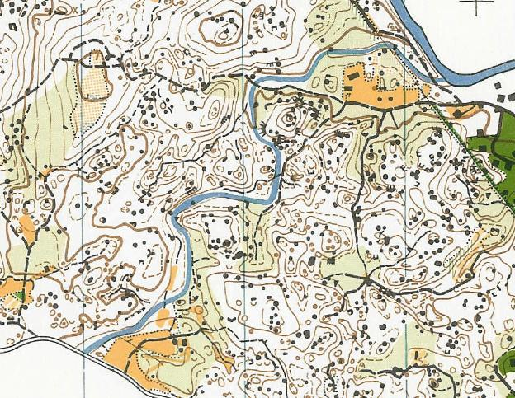
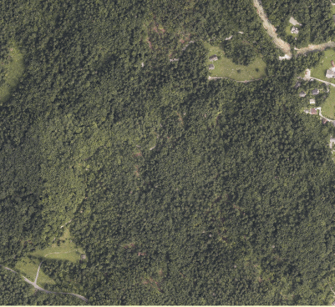
Traditional source data:
Topographic maps
Aerial images, orthophoto
GPS survey

Slide 4
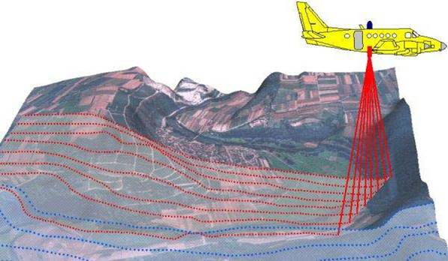
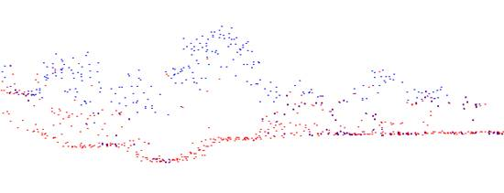
The airborne laser scanning data -
promising source data for deriving different topographic data

Slide 5
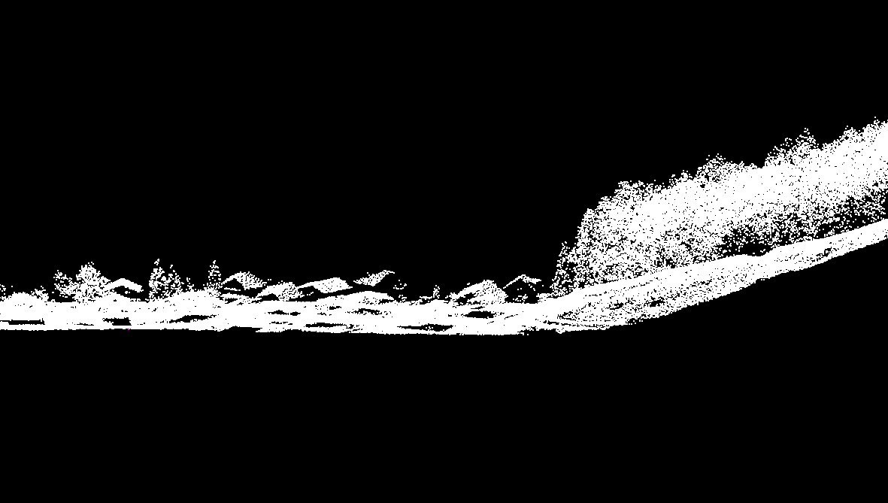
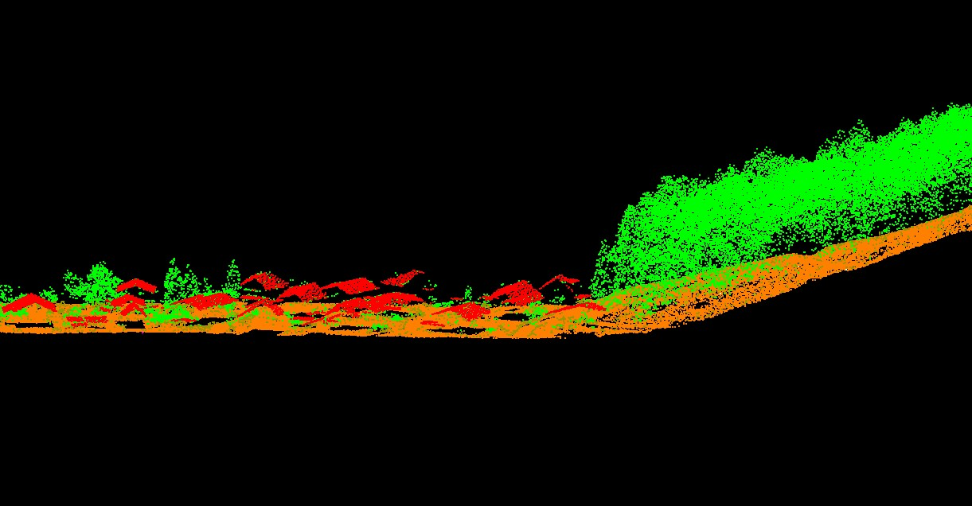
Deriving data from ALS:
automated (urban environment or forestry)
manual recognition of objects in different derived presentations (eg. hillshading)

Slide 6
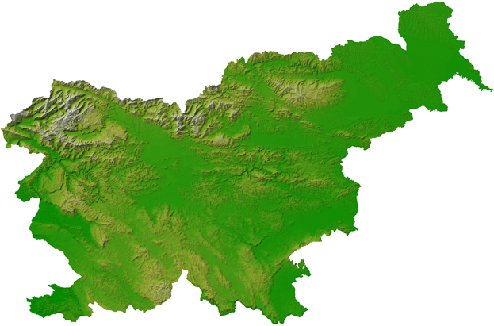
small test areas on different parts of Slovenia
representing different types of terrain:
area near Ljubljana: steep continental relief
area near Domžale: steep carst terrain
area near Lipica (Karst): moderate carst terrain, first echo
O-map
ALS hillshading
ALS derived contours
* 0.5 m, 5-15pt/m2
2
1
3

Slide 7
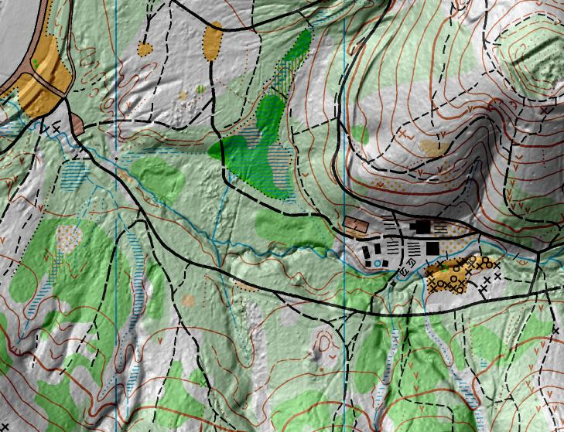
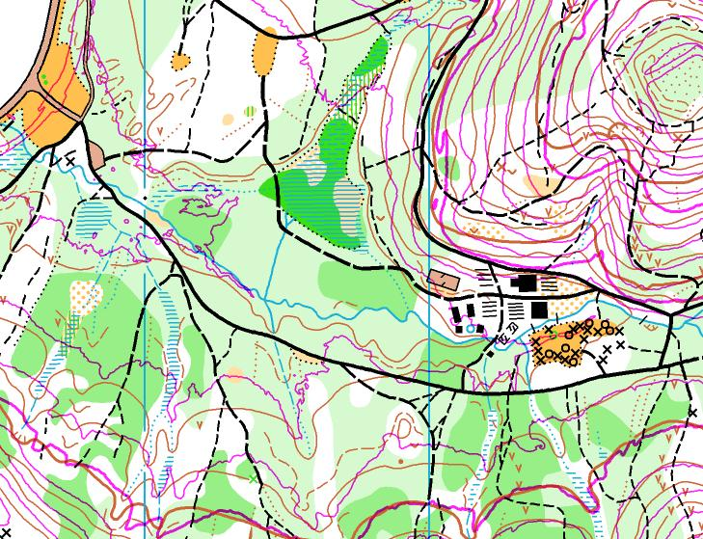

Slide 8
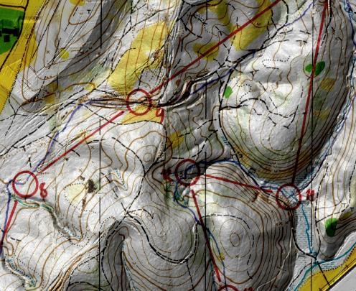
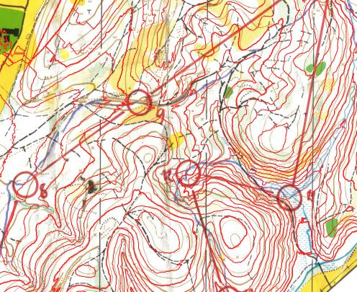

Slide 9
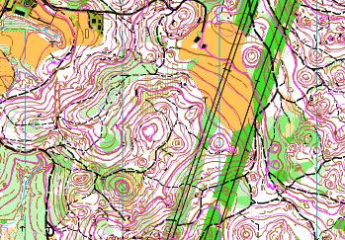

Slide 10
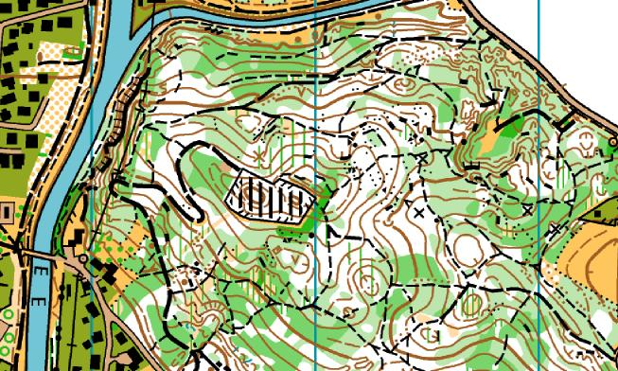
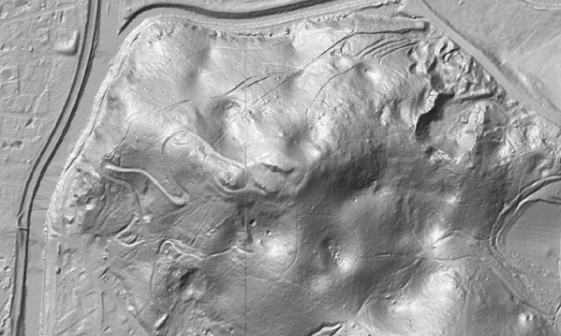

Slide 11
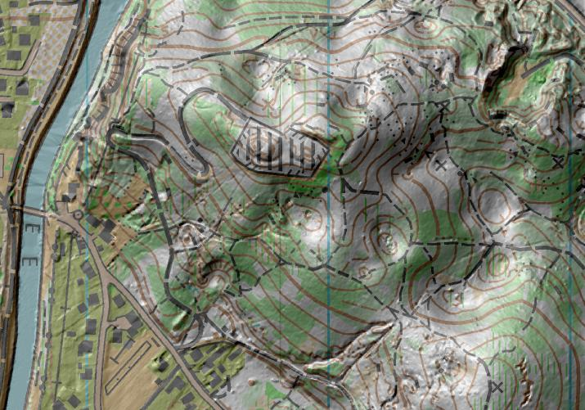
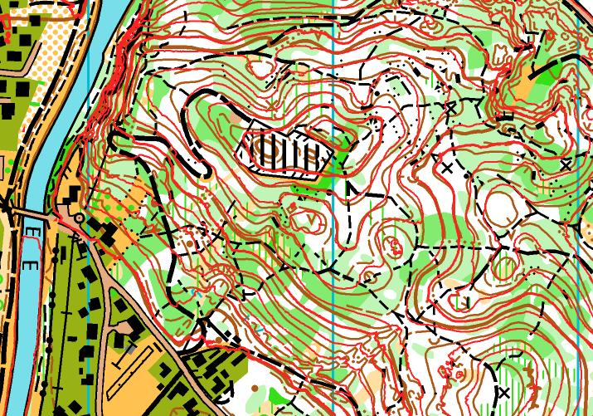

Slide 12
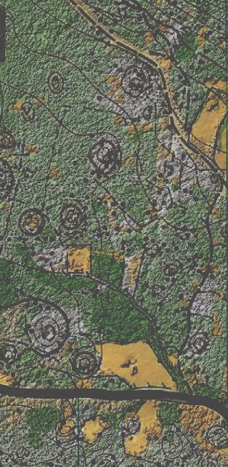
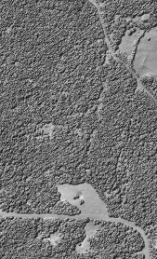
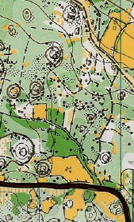

Slide 13
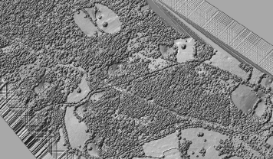
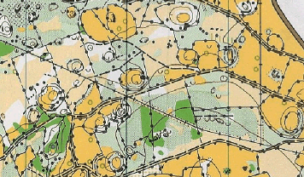

Slide 14
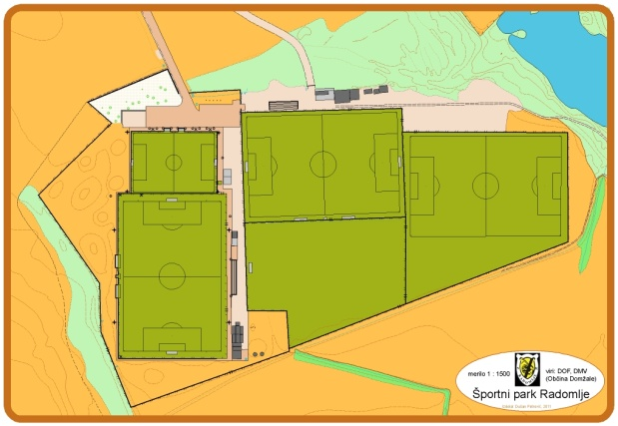
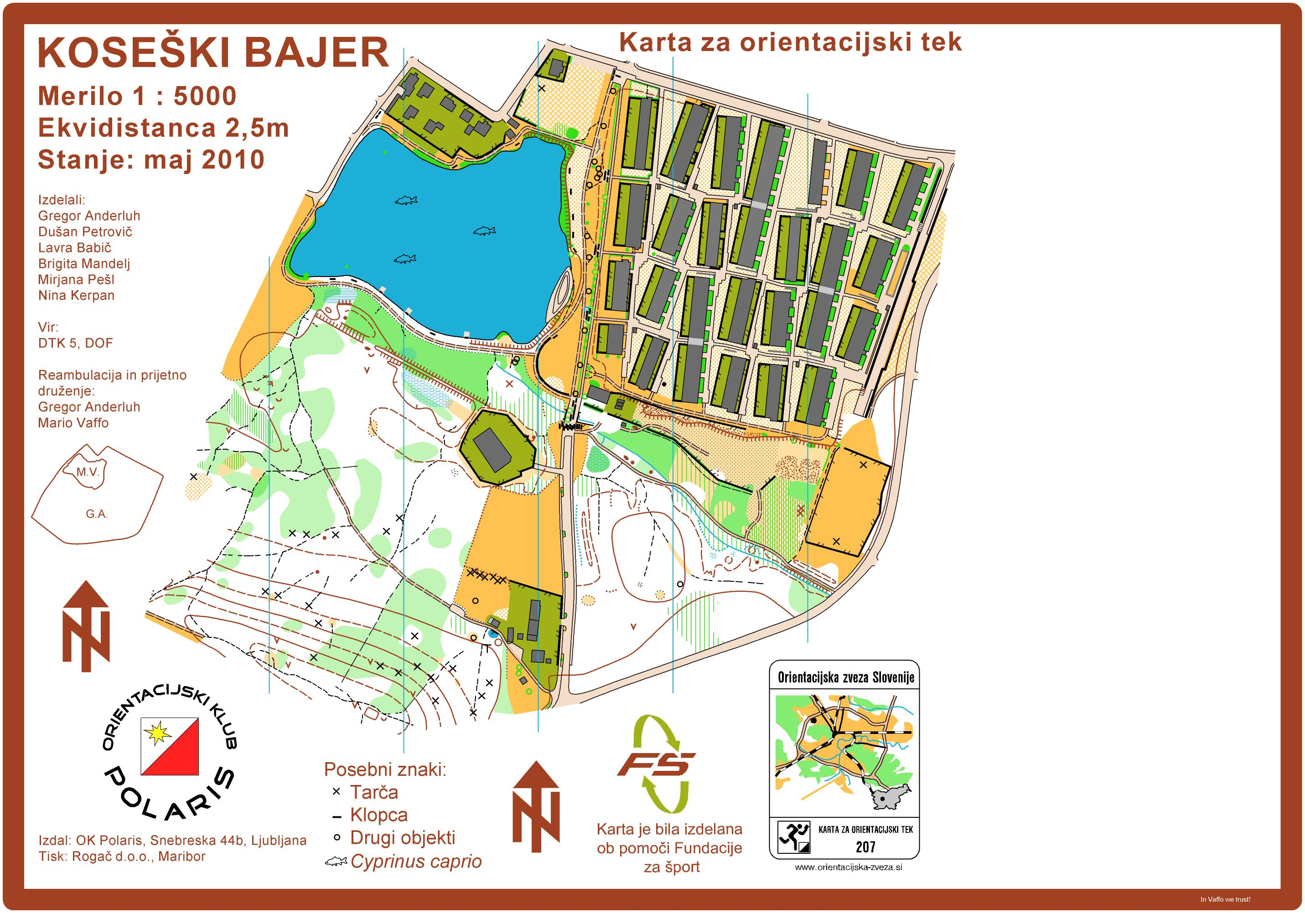
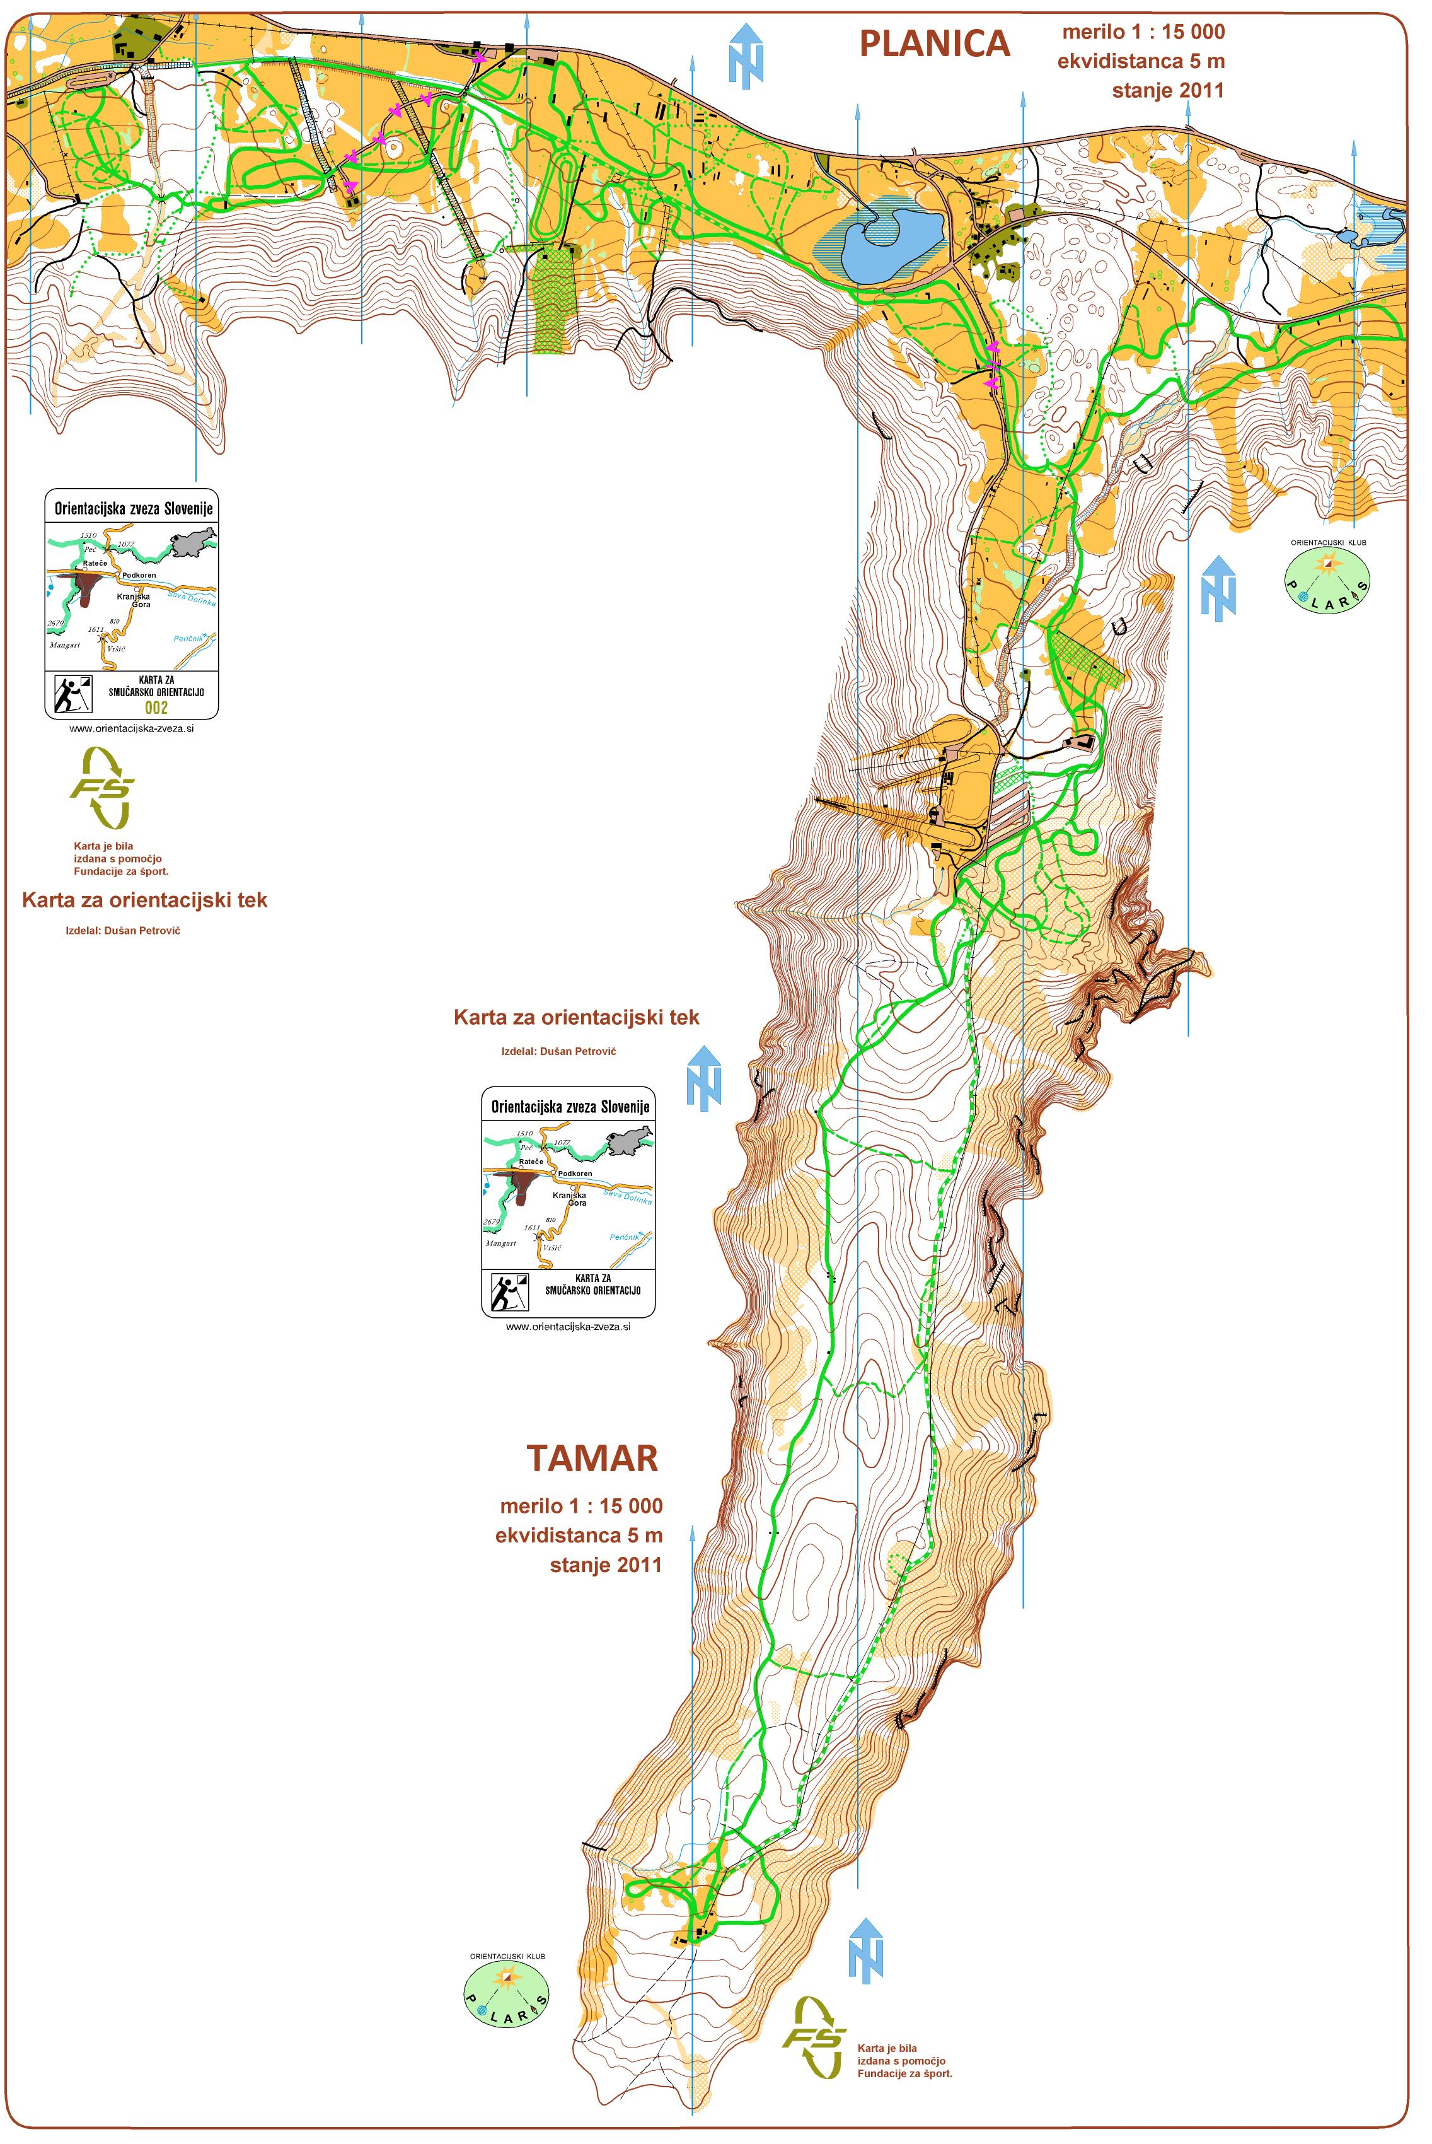
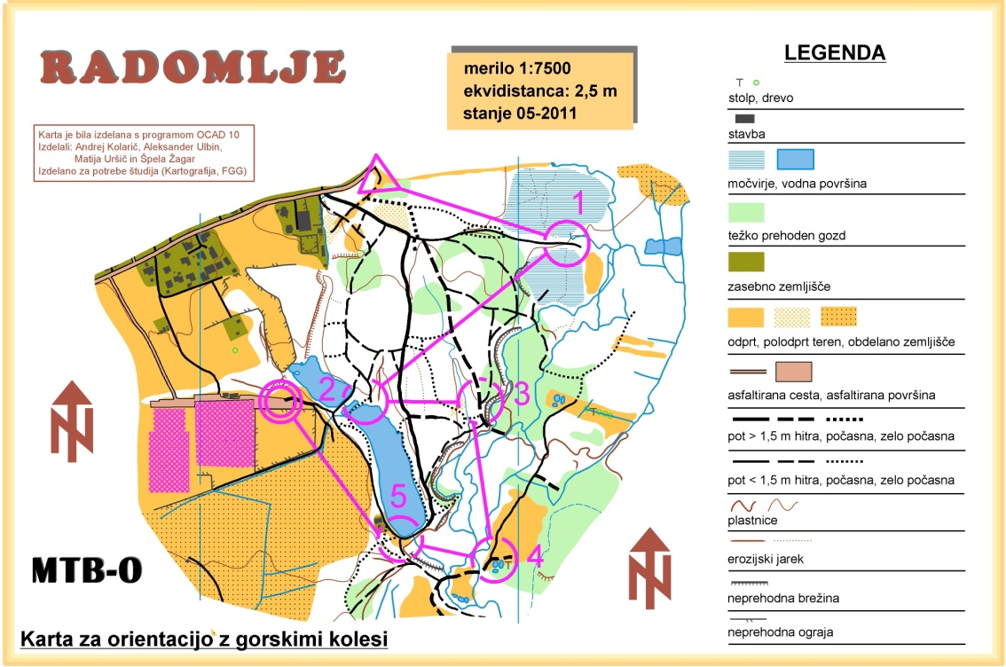
Maps made using LiDAR data

Slide 15
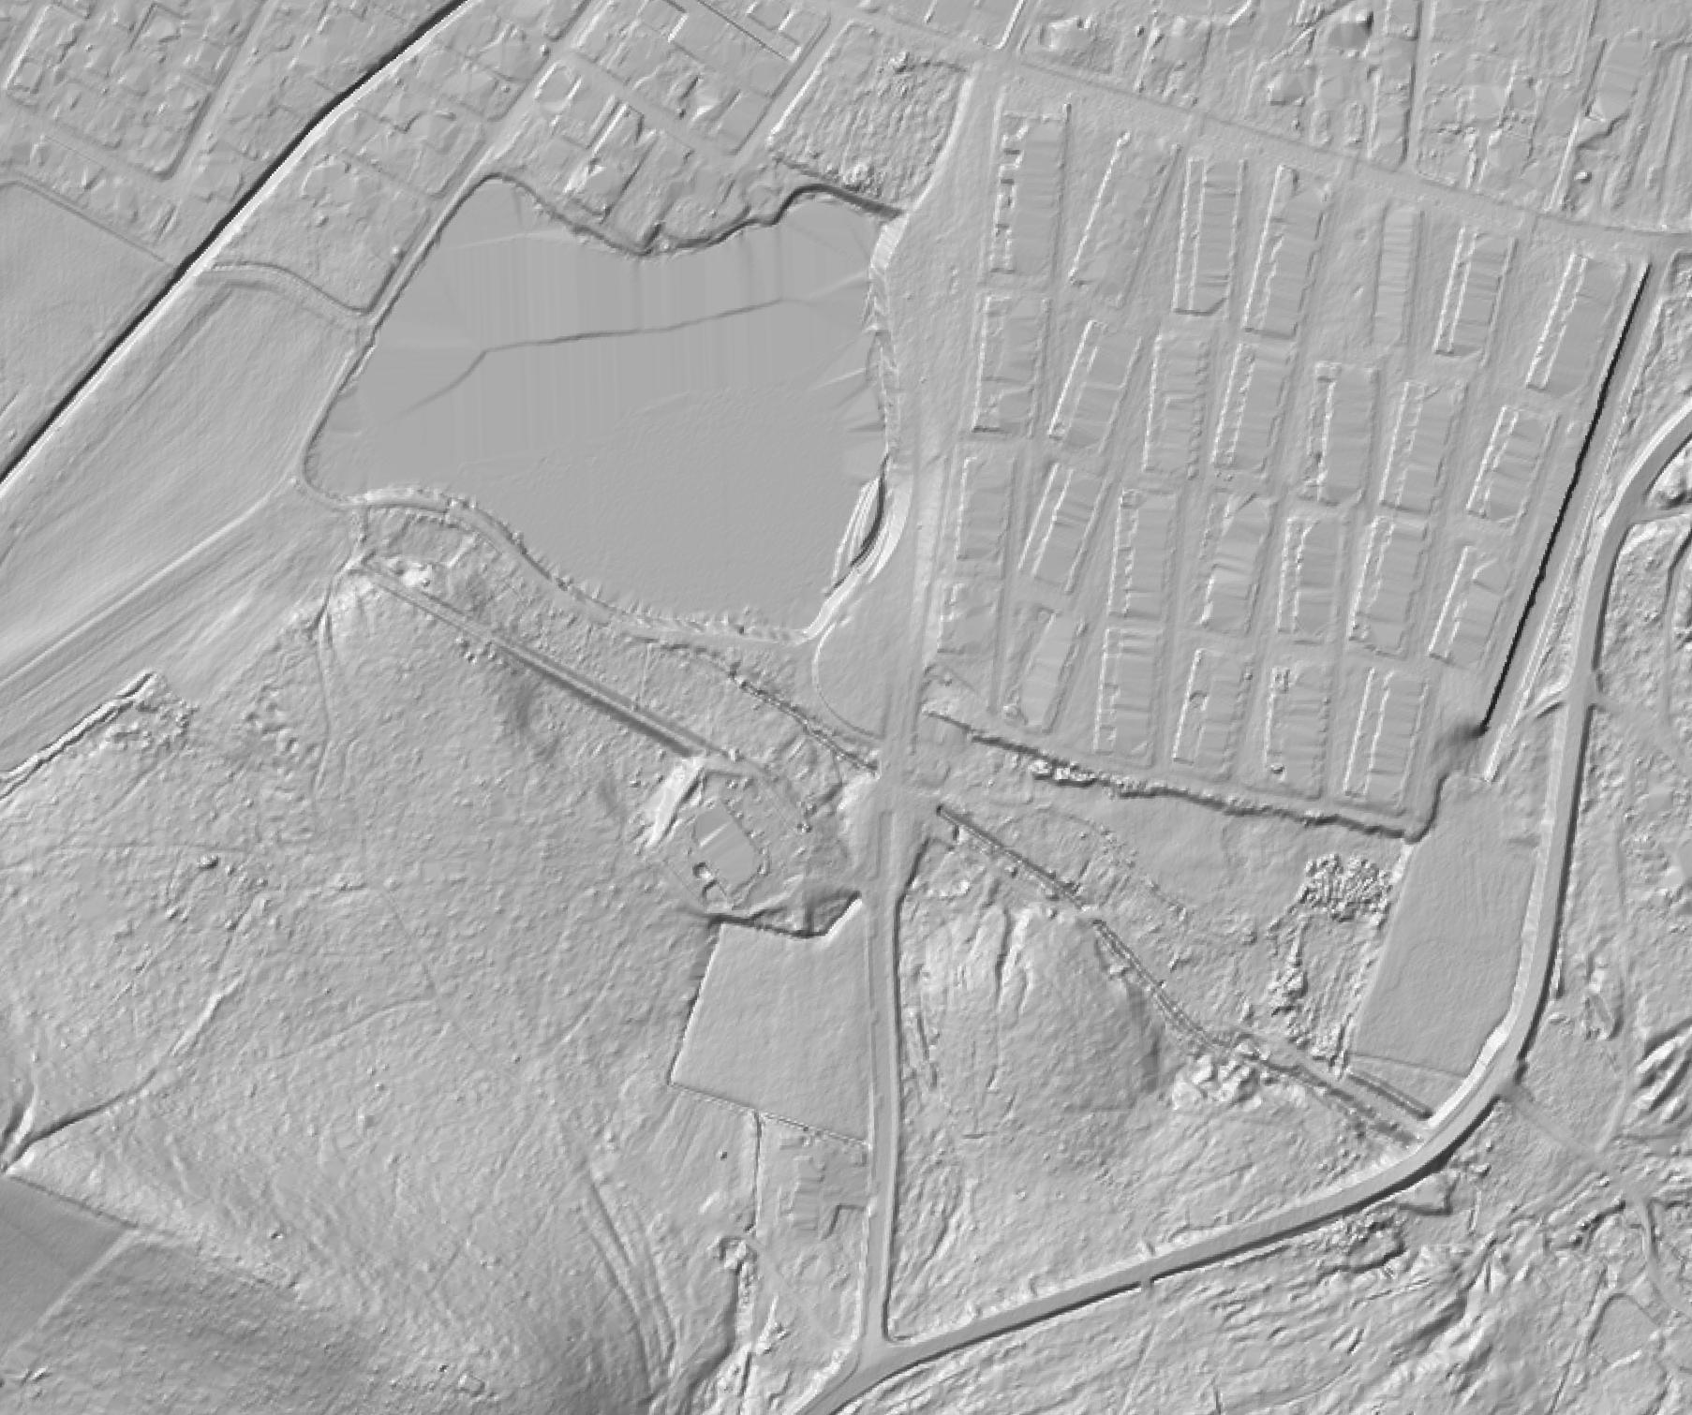
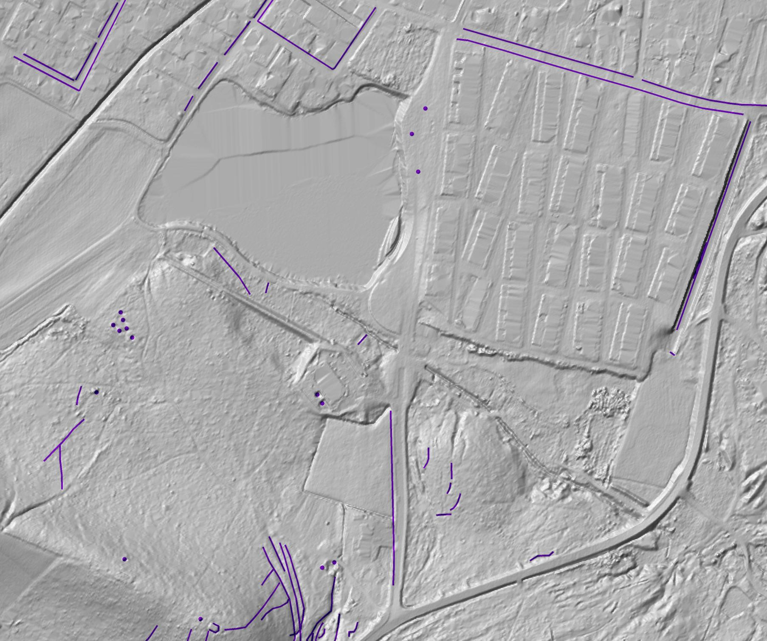

Slide 16
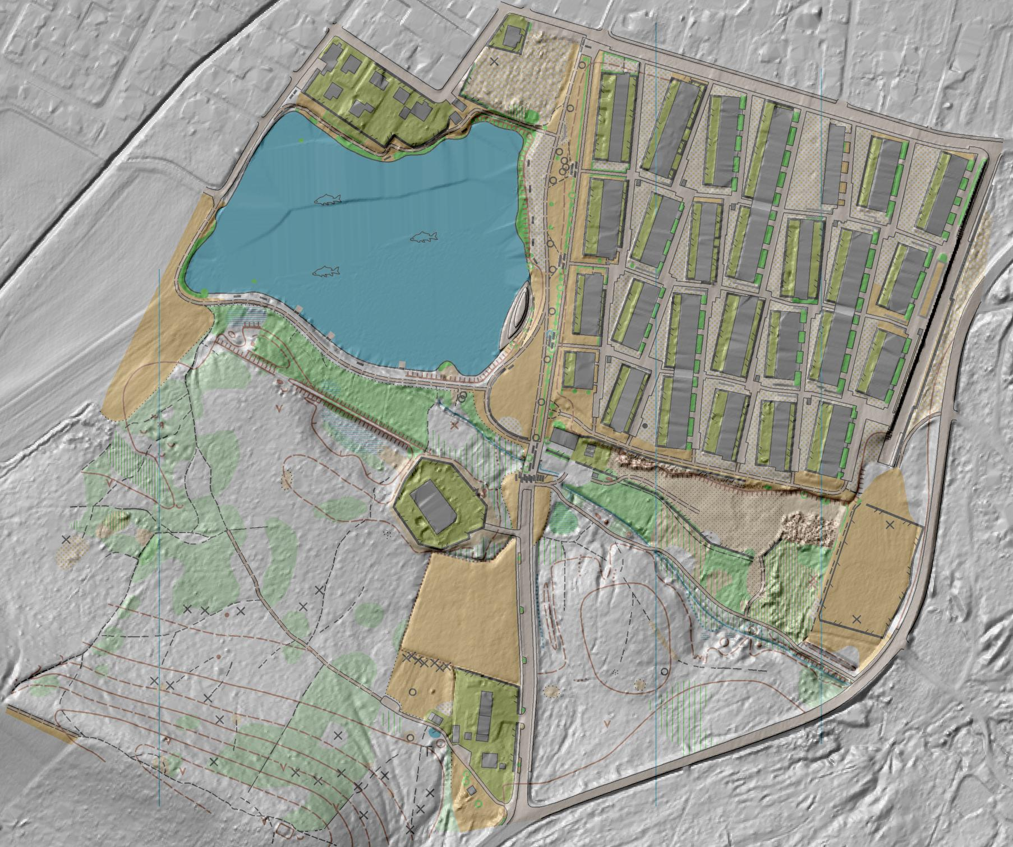

Slide 17
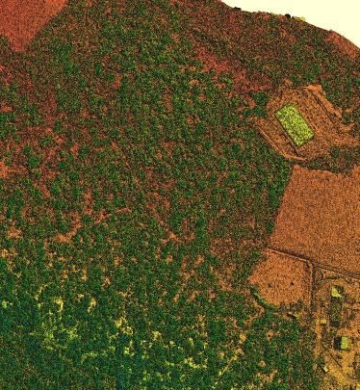

Slide 18
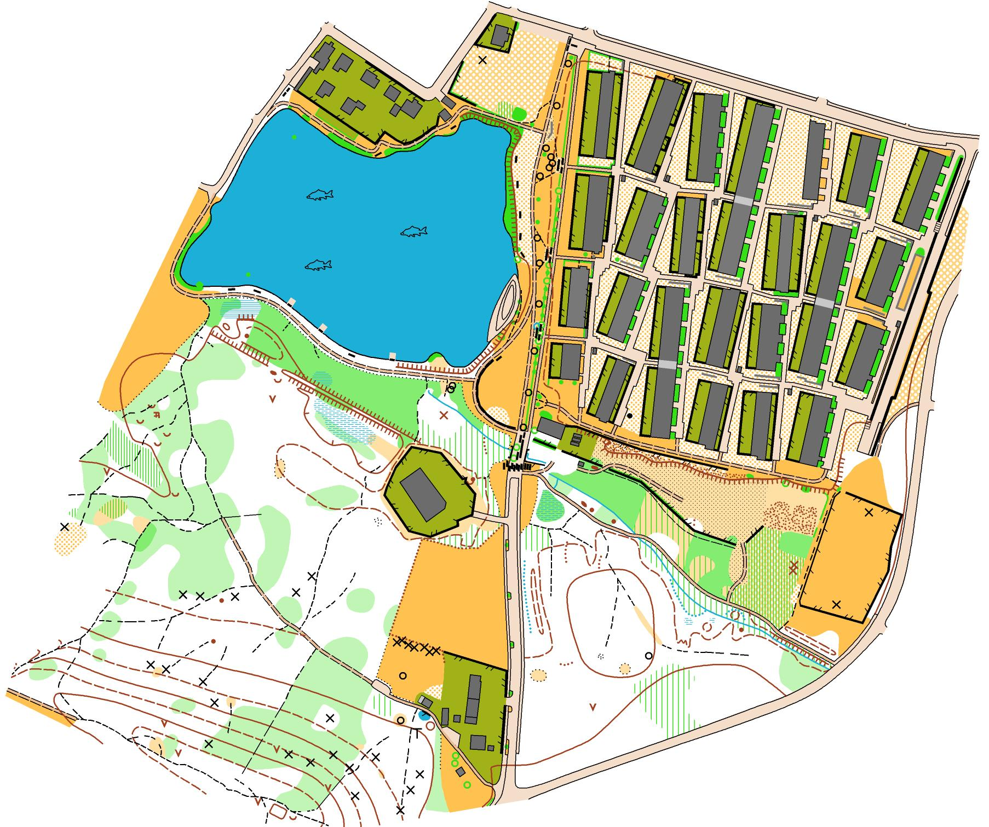

Slide 19
Sprint map (ISSOM)
DEM 0.5 m
50% time

Slide 20
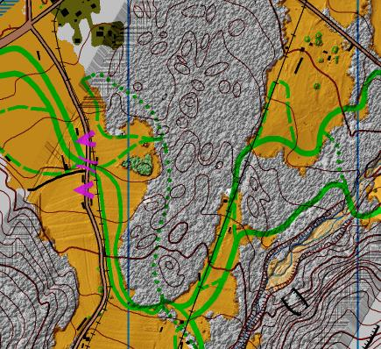
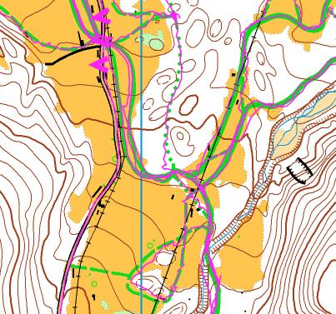
SKI-O map
8 sq.km
DTK5
DEM 0.5 m
DSM 5 pt/m2
orthophoto 0.5 m
GPS (ratrac, scuter)
2 hours field check

Slide 22
SKI-O map
8 sq.km
DTK5
DEM 0.5 m
DSM 5 pt/m2
orthophoto 0.5 m
GPS (ratrac, scuter)
2 hours field check

Slide 23
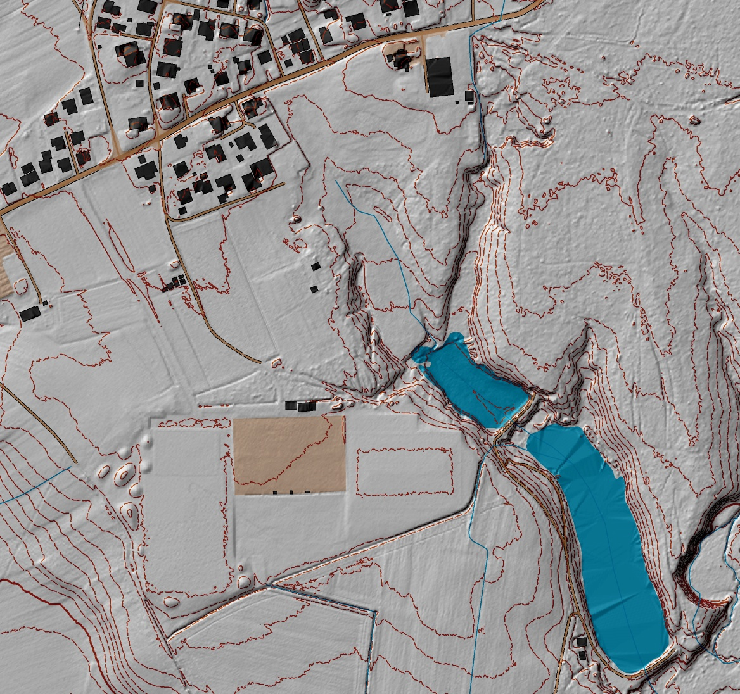
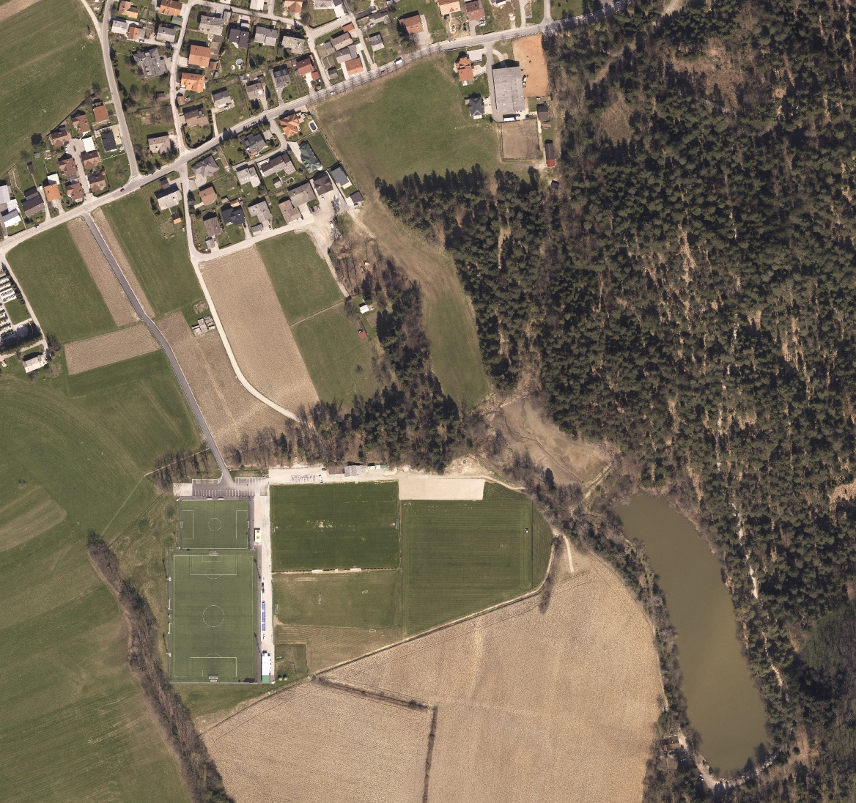
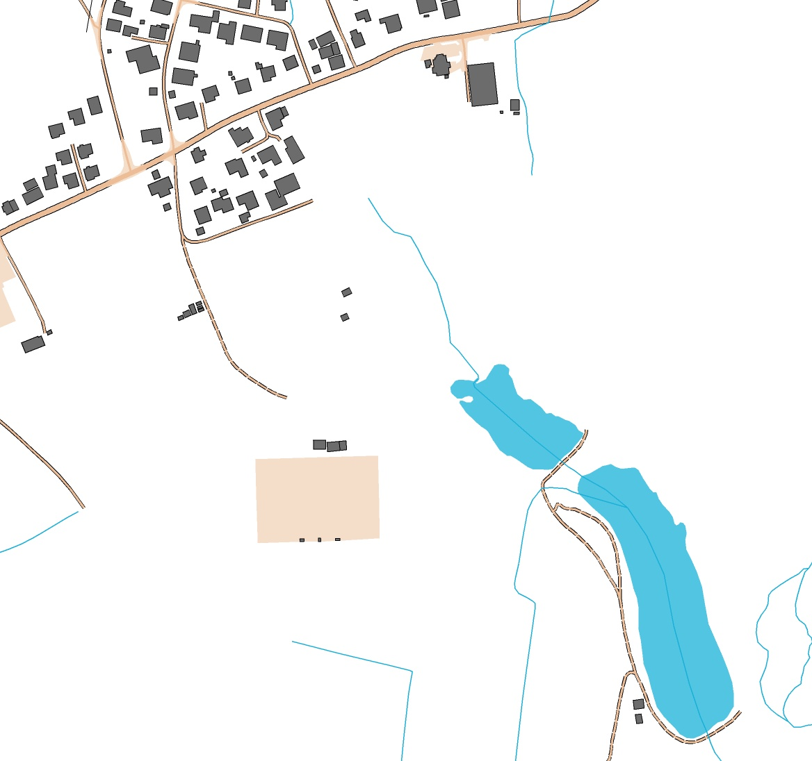
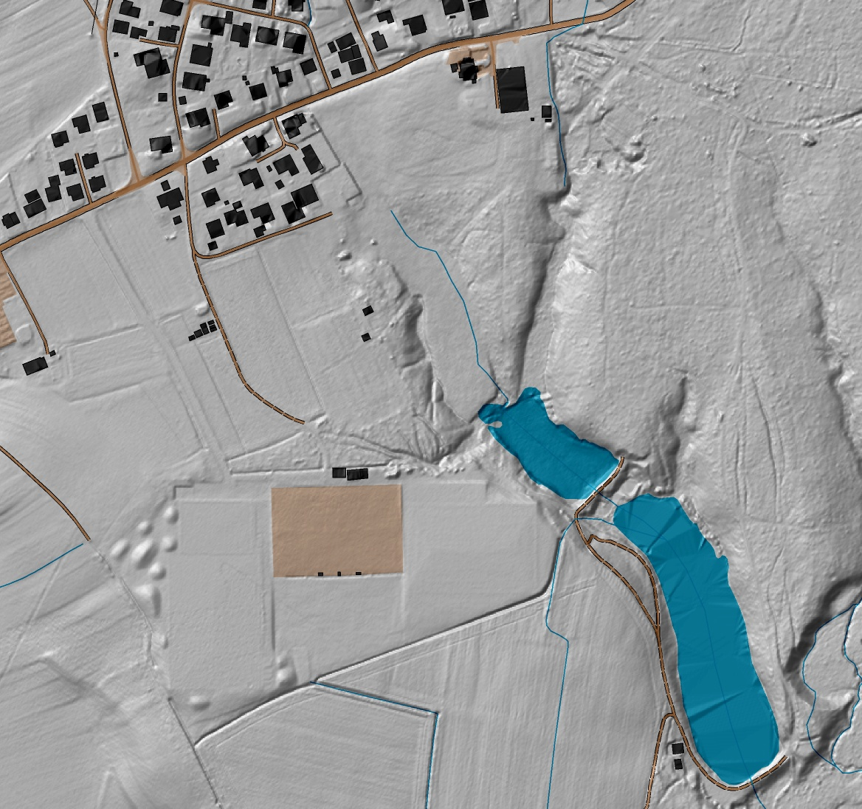
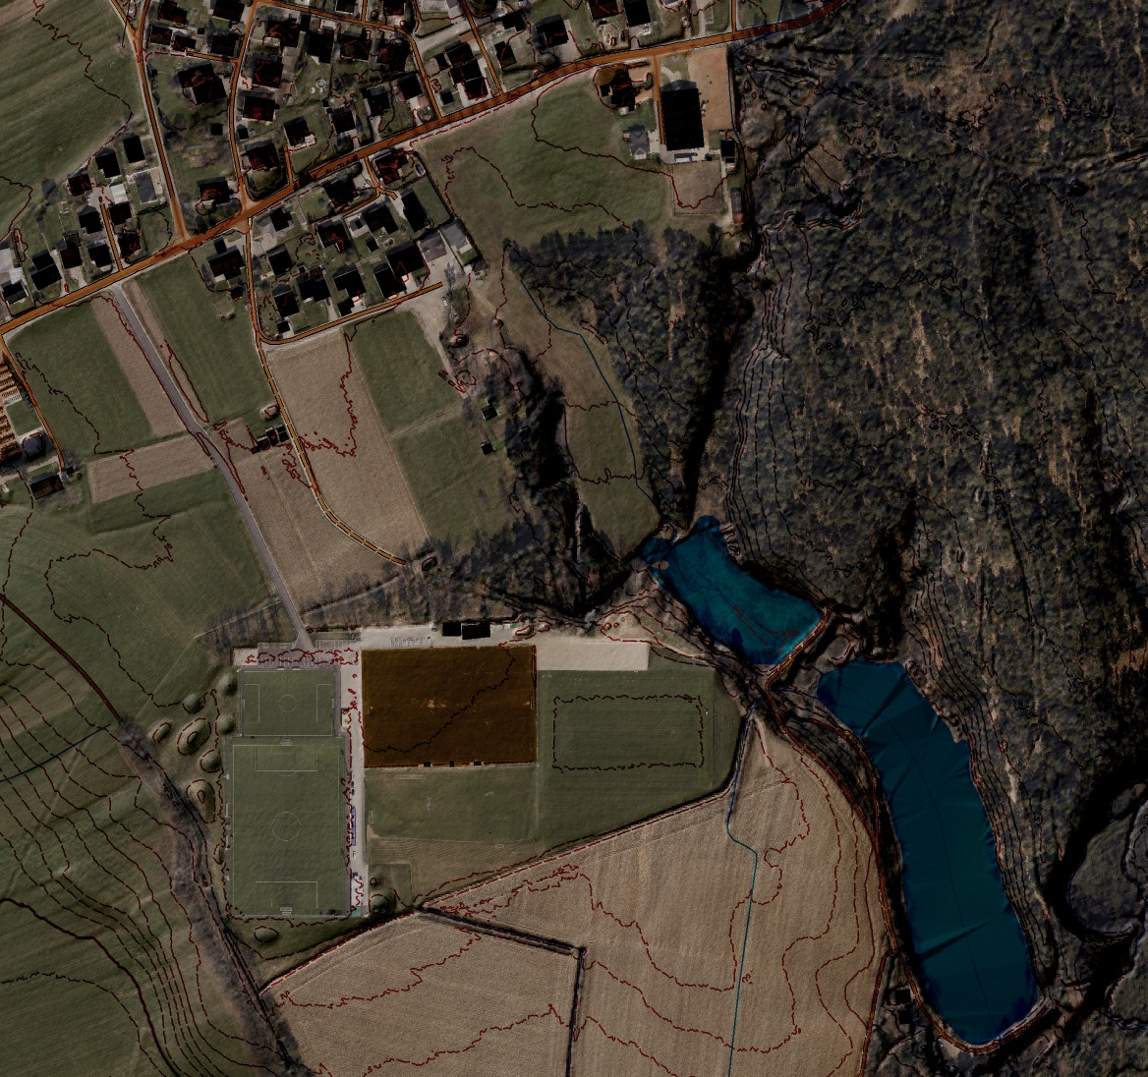
DTK5
DEM 0.5 m
DSM 10 pt/m2
orthophoto 0.1 m
(april)

Slide 24
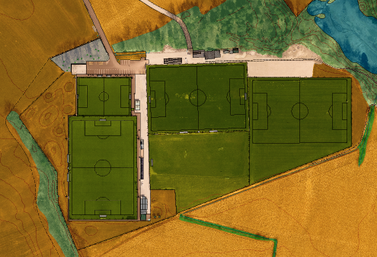
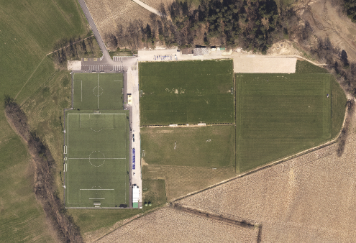
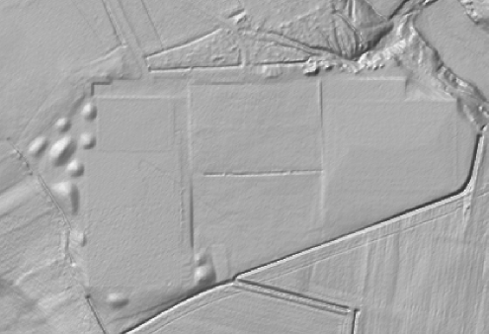

Slide 26
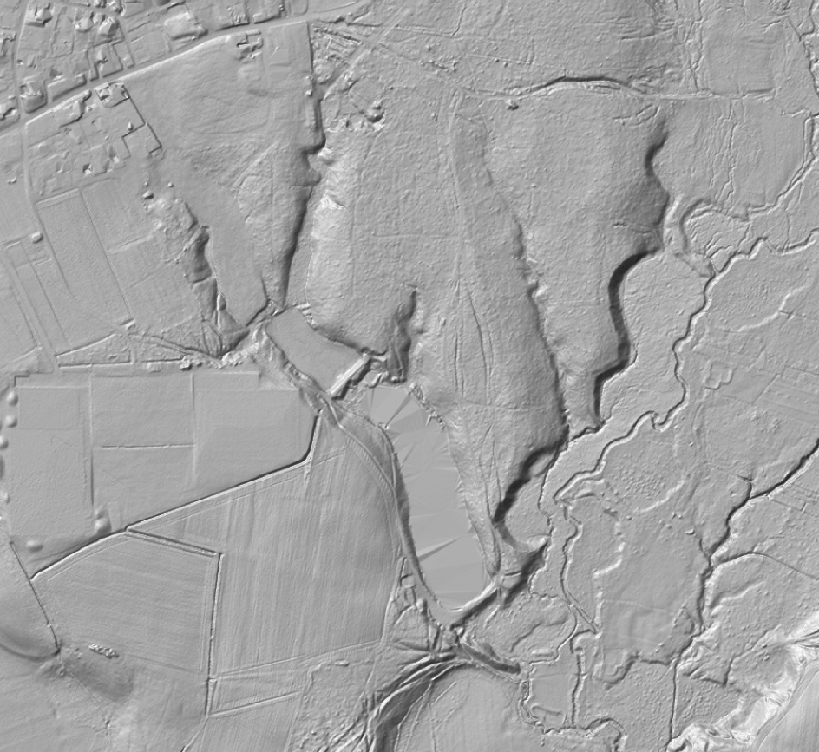
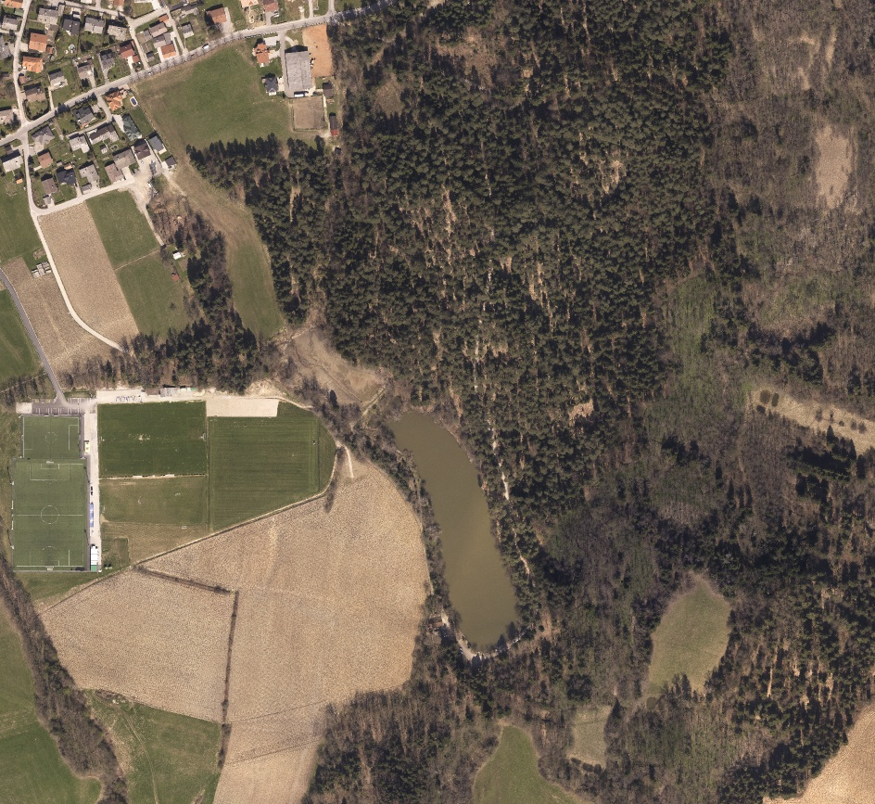
MTBO map
DEM 0.5
OP 0.1 m
(april)
2 hours
(tracks)

Slide 27
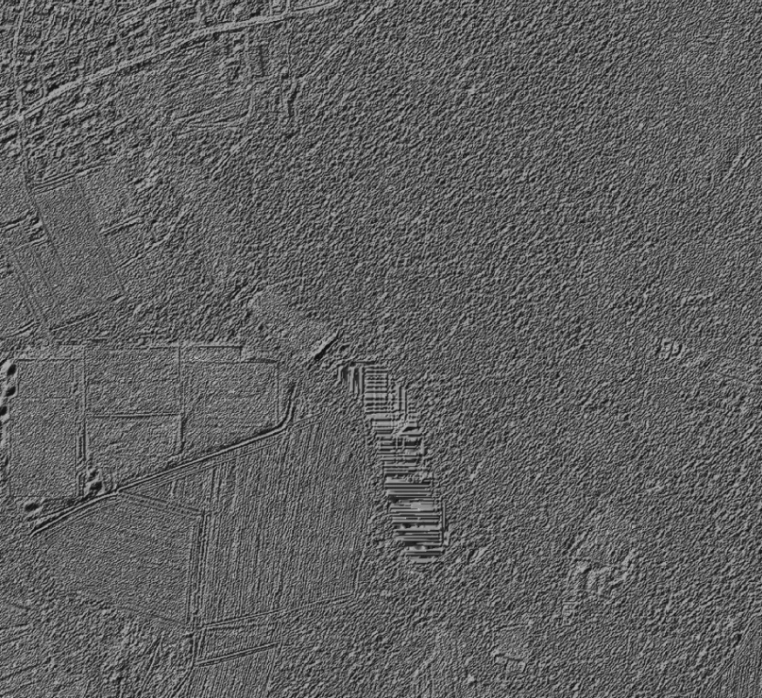

Slide 28
Conclusions
Daniel Lebar: „Don‘t you ever ask me to make an O-map on the area not covered with LiDAR data!“

